Slide 2
Different ways of writing

Slide 3
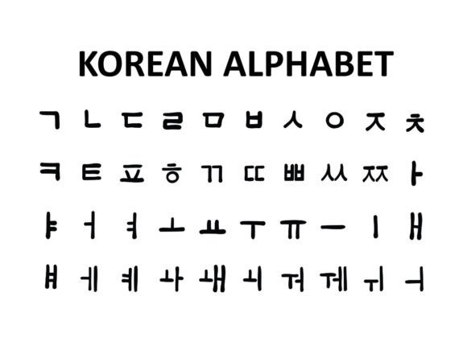
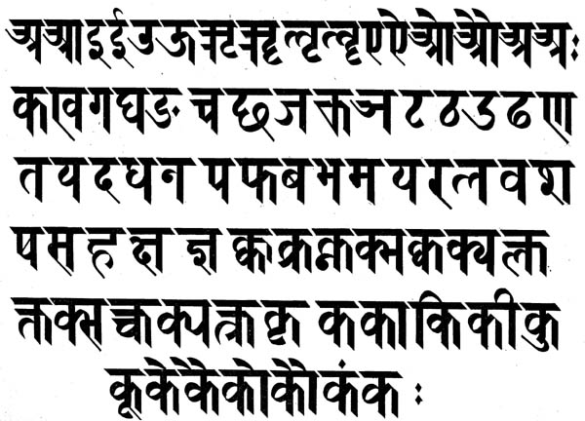
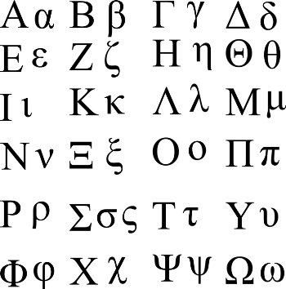
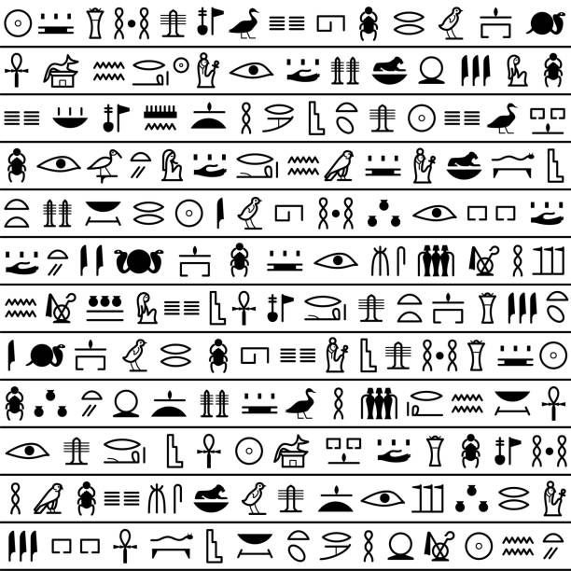

Slide 4
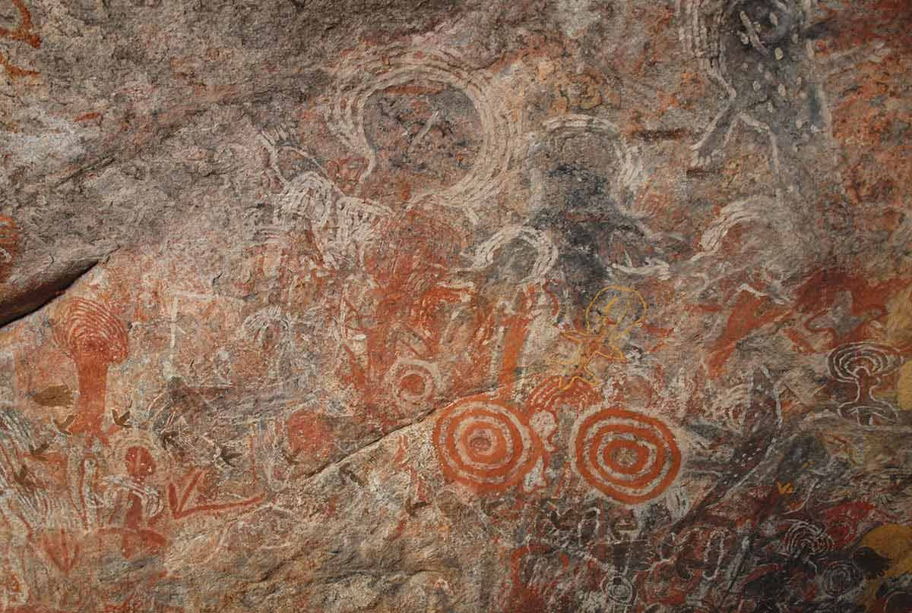
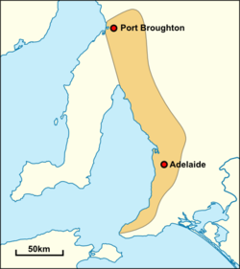
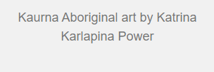

Slide 5
Ways of Writing English compared to Japanese

Slide 6
Ways of Writing English compared to Japanese
Alphabet

Slide 7
Ways of Writing English compared to Japanese
Alphabet
Made up of Letters

Slide 8
Ways of Writing English compared to Japanese
Alphabet
Made up of Letters
Upper case
Lower case

Slide 9
Ways of Writing English compared to Japanese
Alphabet
Made up of Letters
Upper case
Lower case
Scripts

Slide 10
Ways of Writing English compared to Japanese
Alphabet
Made up of Letters
Upper case
Lower case
Scripts
Characters

Slide 11
Ways of Writing English compared to Japanese
Alphabet
Made up of Letters
Upper case
Lower case
Scripts
Characters
Hiragana
Katakana
Kanji

Slide 12
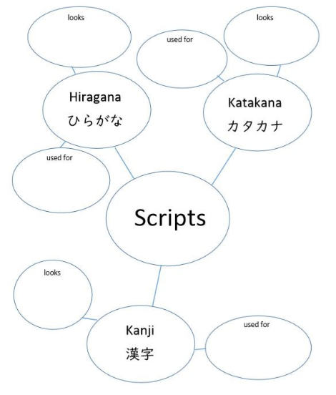

Slide 13
Hiragana
ひらがな
Look round and curvy
Used for native Japanese words
Katakana
カタカナ
Look straight and pointy
Used for foreign words
Kanji
漢字
Look complicated
Used for whole words

