Slide 1
Japanese Scripts
on packages
Decide which script is being used for numbers 1-10

Slide 2
1.
2.
3.

Slide 3
4.

Slide 4
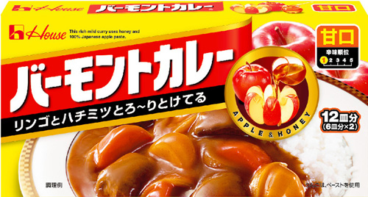
5.
6.

Slide 5
7.
8.

Slide 6
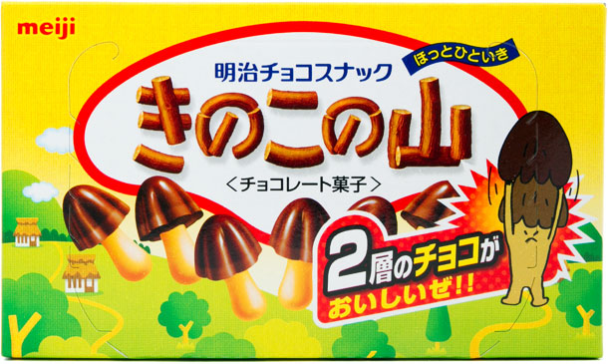
9.
10.

Slide 7
