Slide 1
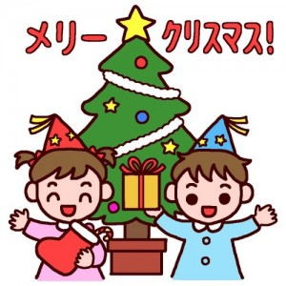
CHRISTMAS IN JAPAN
クリスマス

Slide 2
When does it occur?
Christmas in Japan occurs on the same day as it does everywhere,
December 25th
１２月２５日
However it is not a public holiday!

Slide 3
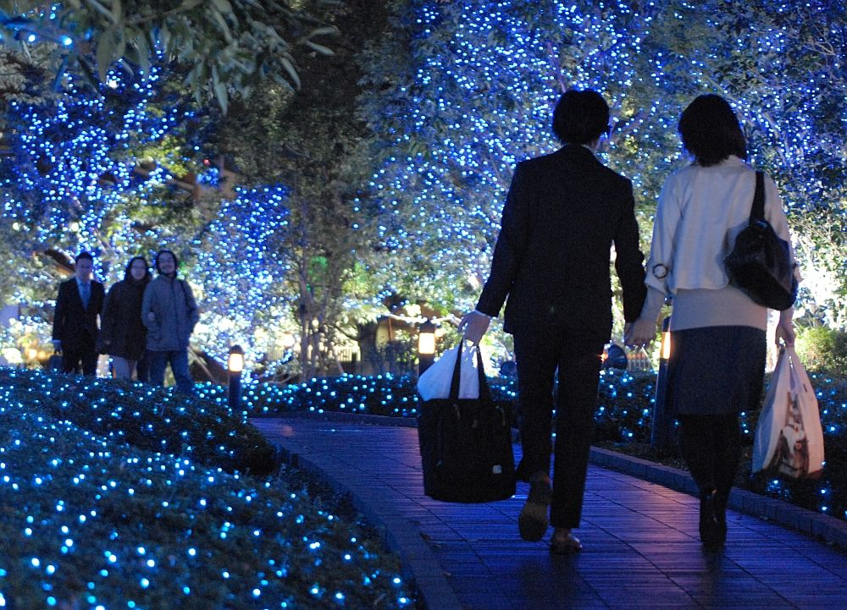
How is it celebrated?
Christmas isn’t a traditional holiday in Japan, but over time has developed as a celebrated event.
Department stores particularly encourage the commercial side of Christmas with huge decorated trees, decorations and Christmas music being played throughout the season. Parents often give gifts to their young children on behalf of Santa.
Christmas Eve in particular is a time when Japanese young people spend time walking along streets lined with Christmas lights with their boyfriend or girlfriend. It is seen as a “Romantic Occasion” similar to Valentines Day.

Slide 4
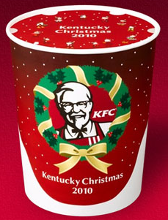
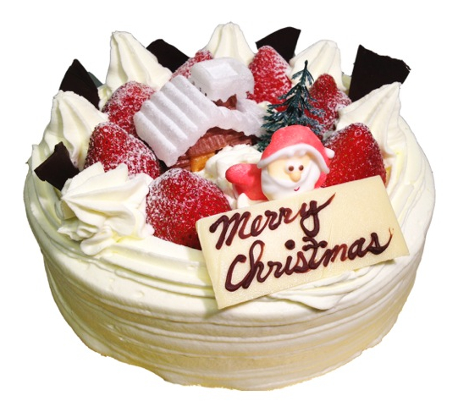
How it is celebrated continued…
At Christmas time the main food eaten is fried chicken. In fact it’s one of KFC’s most popular days.
The other food traditionally eaten is Christmas cake. It’s a sponge cake covered in cream and strawberries, decorated with trees, flowers and other Christmas symbols.

Slide 5
Bibliography
Information
Images

